Slide 1


Francisco Andrés García Torres
2022-29-05
https://github.com/MasterDuriel/DataScience

Slide 2

Outline
Executive Summary (3)
Introduction (4)
Methodology (5-16)
Results (17-46)
Conclusion (47)
Appendix (48)

Slide 3
Executive Summary
For this project, data from the SpaceX API and public data from the wikipedia site were used.
The objective is to make models with machine learning that based on the public data of space X rocket landings allow us to predict the landing success rate in future launches.
An exploratory data analysis (EDA) was performed, including data analysis, data visualization, and interactive visual analysis.
The data obtained were subjected to four machine learning models: Logistic Regression, Support Vector Machine, Decision Tree Classifier and K Nearest Neighbors.
With this, it was sought to obtain the accuracy index of each model, which yielded similar results with an accuracy index greater than 80% in each model.
Despite the success in accuracy, more data is required to make better approximations.

Slide 4
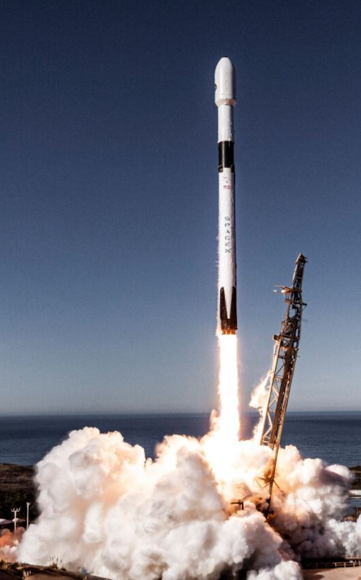
Introduction
Due to the advances of space X launch a rocket into space in a relatively cheap figure ($ 62 million per launch). This has sparked the interest of governments and private industries in space exploration.
The challenge now is to use artificial intelligence algorithms to predict information that minimizes costs and maximizes mission success: Is launch success prediction possible using previous Space X data and machine learning algorithms?
space X Falcon 9

Slide 5

Section 1

Slide 6
Methodology
Data collection methodology:
Data From: Space X API
WebScraping from Wikipedia
Perform data wrangling
The collected data were assigned landing result labels to later group and analyze the information.
Perform exploratory data analysis (EDA) using visualization and SQL

Slide 7
Methodology
Perform interactive visual analytics using Folium and Plotly Dash
Perform predictive analysis using classification models
How to build, tune, evaluate classification models
The data that was collected was normalized, and later divided into training data and test data sets to be evaluated by four different classification models.

Slide 8

Data Collection
The data was obtained through public data from two sources:
Data obtained from: Space X API: (https://api.spacexdata.com/v4/rockets/
Public data extracted by WebScraping from Wikipedia

Slide 9
Data Collection – SpaceX API
Request (Space X APIs)
Normalize to DataFrame data from JSON
Filter data to only include Falcon 9 launches
Process missing values
)
Json_
https://github.com/MasterDuriel/DataScience/blob/master/Module%2010%20Applied%20Data%20Science%20Capstone/Data%20Collection%20API.ipynb.ipynb

Slide 10
Data Collection - Scraping
Request Wikipedia
Extract all column and variable
Create dictionary
Convert Dictionary to DataFrame
)
Json_
https://github.com/MasterDuriel/DataScience/blob/master/Module%2010%20Applied%20Data%20Science%20Capstone/Webscraping.ipynb

Slide 11
Data Wrangling
An exploratory data analysis (EDA) was performed on the data set.
Using the launch data and results of each orbit, the results of each mission in each orbit are calculated.
From the results, the Landing Results label was created.
)
Json_
https://github.com/MasterDuriel/DataScience/blob/master/Module%2010%20Applied%20Data%20Science%20Capstone/Data%20wrangling.ipynb

Slide 12
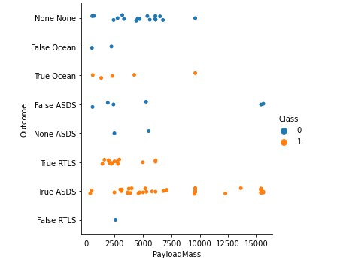
EDA with Data Visualization
Relationship between Payload and Orbit type
Data exploration was performed using graphics: scatterplots and barplots were used.
The relationship between the variables was analyzed: Payload Mass X Flight Number, Launch Site X Flight Number
https://github.com/MasterDuriel/DataScience/blob/master/Module%2010%20Applied%20Data%20Science%20Capstone/EDTA%20with%20Vizualitation.ipynb

Slide 13
EDA with SQL
The data set was loaded to build tables in the IBM DB2 database.
Queries were made through the integration of SQL Python.
We Queries were made to gain a better understanding of the data set.
We Extracted Information queried on launch site names, mission results, various client payload sizes and booster versions, and landing results
https://github.com/MasterDuriel/DataScience/blob/master/Module%2010%20Applied%20Data%20Science%20Capstone/EDA%20With%20SQL.ipynb

Slide 14
Build an Interactive Map with Folium
We use different markers circle markers, line markers and marker groups with Folium Maps
Added markers to launch sites
We add circles at specific coordinates like NASA Johnson SpaceCenter
We add lines to indicate distances between two coordinates.
https://github.com/MasterDuriel/DataScience/blob/master/Module%2010%20Applied%20Data%20Science%20Capstone/EDA%20With%20SQL.ipynb

Slide 15
Build a Dashboard with Plotly Dash
For this section we created a dashboard with multiple charts and graphs for data visualization, including a pie chart and a scatter plot.
With these visual elements we perform analyzes and create relationships between payloadsand launch sites, helping to identify the best place to launch based onto payloads.
https://github.com/MasterDuriel/DataScience/blob/master/Module%2010%20Applied%20Data%20Science%20Capstone/Build%20an%20Interactive%20Dashboard%20with%20Ploty%20Dash.ipynb

Slide 16
Predictive Analysis (Classification)
The accuracy of four models was used and compared: logistic regression, support vector machine, decision tree, and k nearest neighbors.
Data preparation and standardization
Testing each model with different hyperparameters
Accuracy of each model
Comparison of results.
https://github.com/MasterDuriel/DataScience/blob/master/Module%2010%20Applied%20Data%20Science%20Capstone/Machine%20Learning%20Prediction.ipynb

Slide 17
Results
Exploratory data analysis results
Results of the exploratory data analysis:
Space X uses 4 different launch sites.
The first successful landing occurred in 2015.
There was a high percentage of successful missions
There were Two booster versions failed to land on drone ships in 2015
The number of landing results improved over the years.

Slide 18

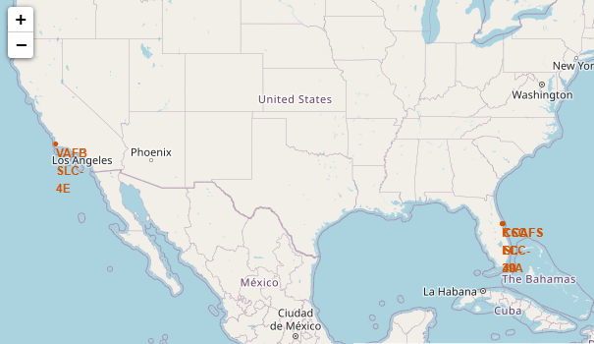
Results
Using an interactive analysis it was possible to identify that the launch sites of safe places.
Launch sites with relatively high success rates.

Slide 19
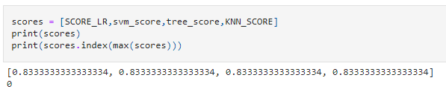
Results
Predictive analysis results
The model results with 83% accuracy.
TASK 12: Find the method performs best:
https://github.com/MasterDuriel/DataScience/blob/master/Module%2010%20Applied%20Data%20Science%20Capstone/Machine%20Learning%20Prediction.ipynb

Slide 20

Section 2

Slide 21
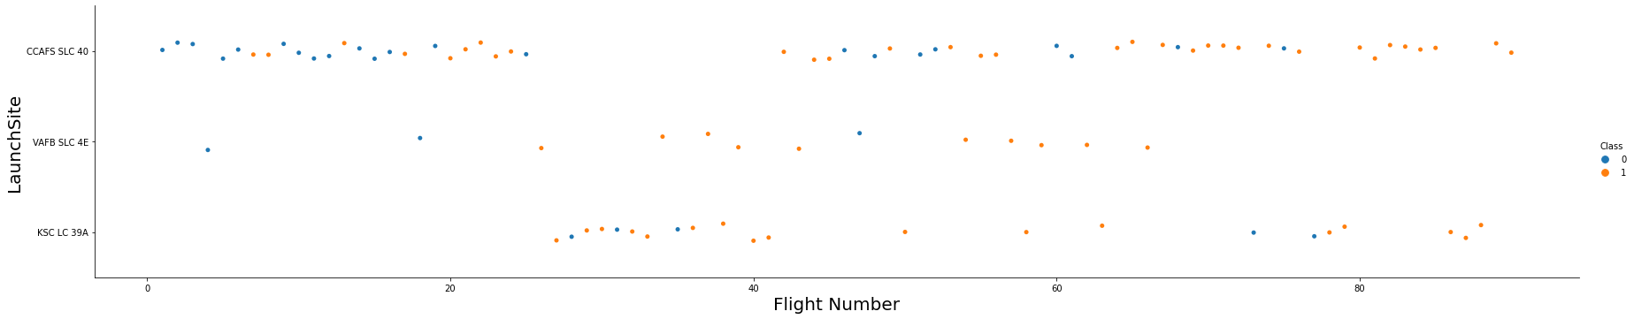
Flight Number vs. Launch Site
According to the diagram, the best launch site is CCAF5 SLC 40, where most of the recent launches were successful
Second is the VAFB SLC 4E site
Third is KSC LC 39A
It is also possible to see an increasing overall rate of success over time.

Slide 22
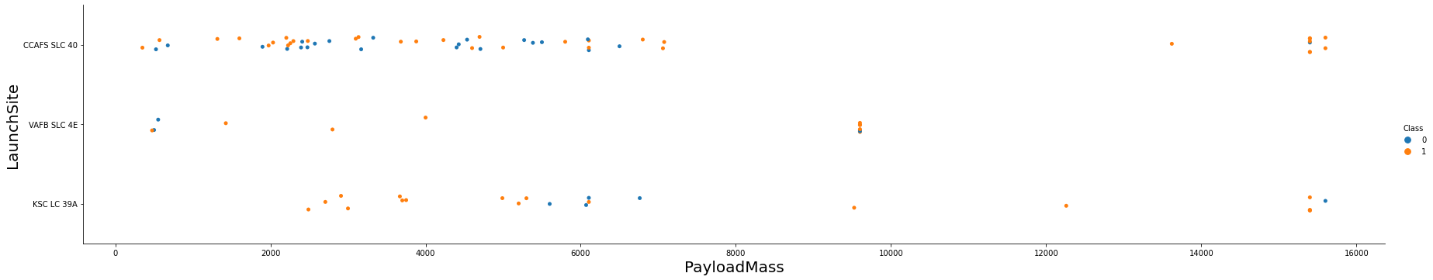
Payload vs. Launch Site
The mass of the payload seems to fall mainly between 0 - 6000 kg. the mass of the payload greater than 6000 kg seems to be negligible.

Slide 23
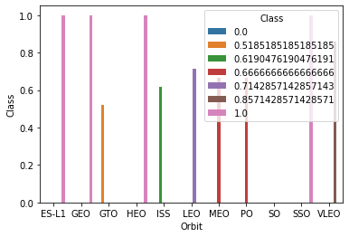
Success Rate vs. Orbit Type
The highest success rates occur in orbits:
ES L1
GEO
HEO
SSO.
Followed by:
GTO (above 60%)
MEO (above 70%)

Slide 24
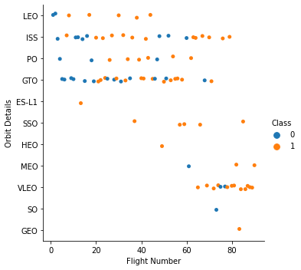
Flight Number vs. Orbit Type
SpaceX started with LEO orbits with success at LEO and now use VLEO for recent launches.
SpaceX launches seem to perform better in lower orbits or sun-synchronous orbits
Success rate improved over time in all orbits

Slide 25
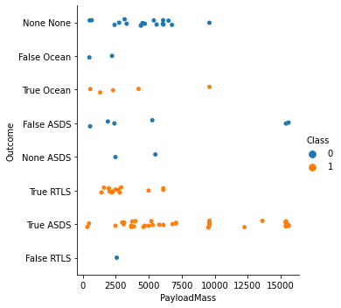
Payload vs. Orbit Type
The payload mass looks like thiscorrelated with orbit LEO and SSO show relatively low payload mass
In the case of most successful on-orbit VLEOs only have payload mass values at the upper end of the range

Slide 26
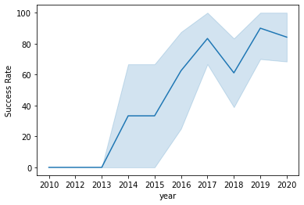
Launch Success Yearly Trend
The increase in the success rate is observed from 2013 consistently until 2020.

Slide 27
All Launch Site Names
There are four launch sites:
Data was obtained by selecting unique occurrences of "launch_site" values.of the data set.
Launch Site
CCAFS LC-40
CCAFS SLC-40
KSC LC-39A
VAFB SLC-4E

Slide 28
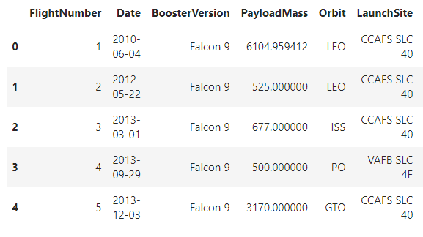
Launch Site Names Begin with 'CCA'
5 records where launch sites begin with `CCA`:

Slide 29
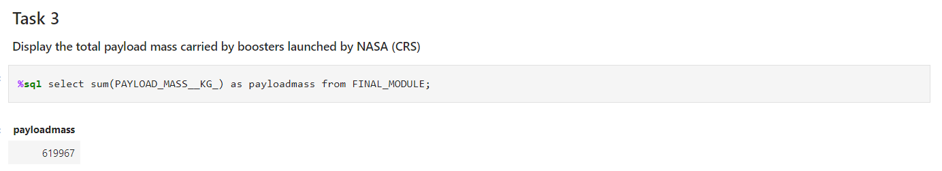
Total Payload Mass
Total payload carried by boosters from NASA:
Total payload calculated above, adding all payloads whose codes contain 'CRS', which stands for NASA.

Slide 30
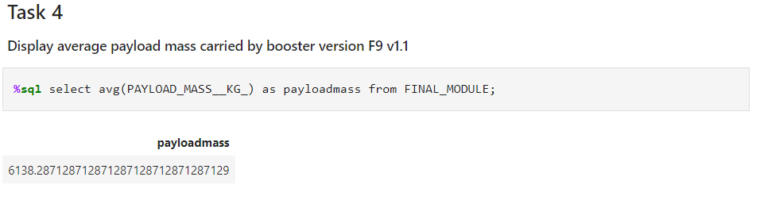
Average Payload Mass by F9 v1.1
Average payload mass carried by booster version F9 v1.1:
Filtering data by previous booster version and calculating the averagepayload mass we got the value of 6,138.28 kg.

Slide 31
First Successful Ground Landing Date
First successful landing outcome on ground pad:
Min Date
2015-12-22
By filtering the data by successful landing result on the ground pad and getting the minimum value for the date when it is possible to identify the first occurrence.

Slide 32
Total Number of Successful and Failure Mission Outcomes
Number of successful and failure mission outcomes:
The results of the missions were grouped to count the success
Mission Outcome Occurrences
Success | 99
Success (payload status unclear) | 1
Failure(in flight) | 1

Slide 33
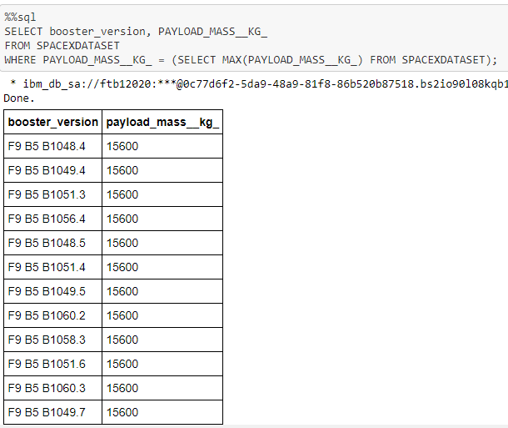
Boosters Carried Maximum Payload
Boosters which have carried the maximum payload mass.
These are the bosters that have carried the maximum payload mass recorded in the data set.

Slide 34
2015 Launch Records
Results of failed landing in unmanned spacecraft, for the year 2015
BoosterVersion | LaunchSite
F9 v1.1 B1012 | CCAFS LC-40
F9 v1.1 B1015 | CCAFS LC-40
Just the two unique appearances

Slide 35
Rank Landing Outcomes Between 2010-06-04 and 2017-03-20
Ranking of all count of landing outcomes (such as Failure (drone ship) or Success (ground pad)) between the date 2010-06-04 and 2017-03-20
This is a alerts of “No attempt”
Landing Outcome | Occurrences
No attempt | 10
Failure(drone ship) | 5
Success(drone ship) | 5
Controlled(ocean) | 3
Success(groundpad) | 3
Failure(parachute) | 2
Uncontrolled(ocean) | 2
Precluded(drone ship) | 1

Slide 36

Section 3

Slide 37
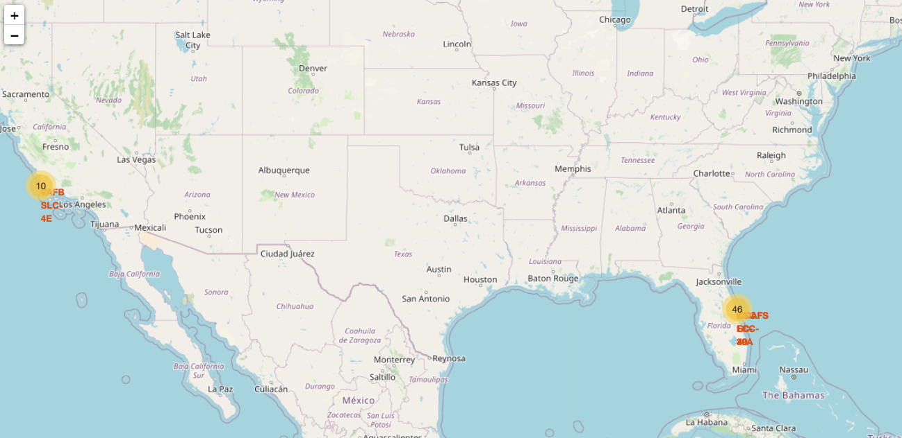
All launch sites
All launch sites are close to water, away from towns, highways and crowded cities.

Slide 38
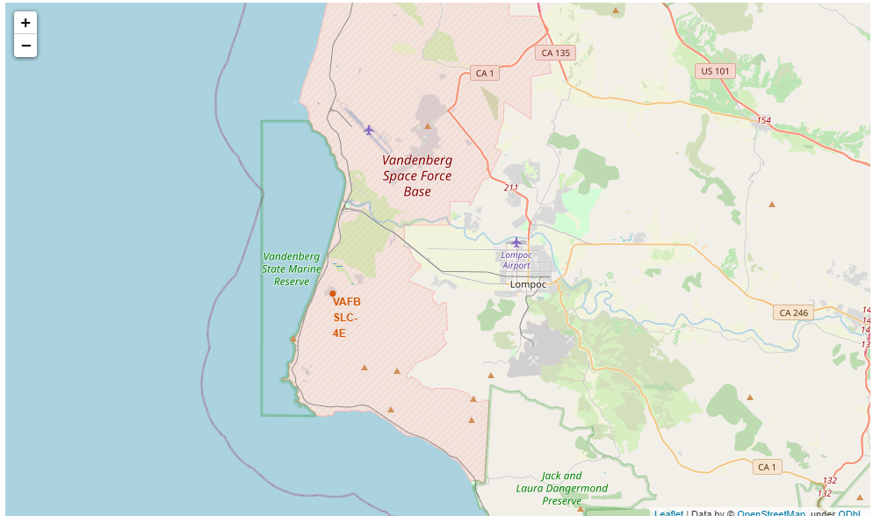
Launch sites

Slide 39
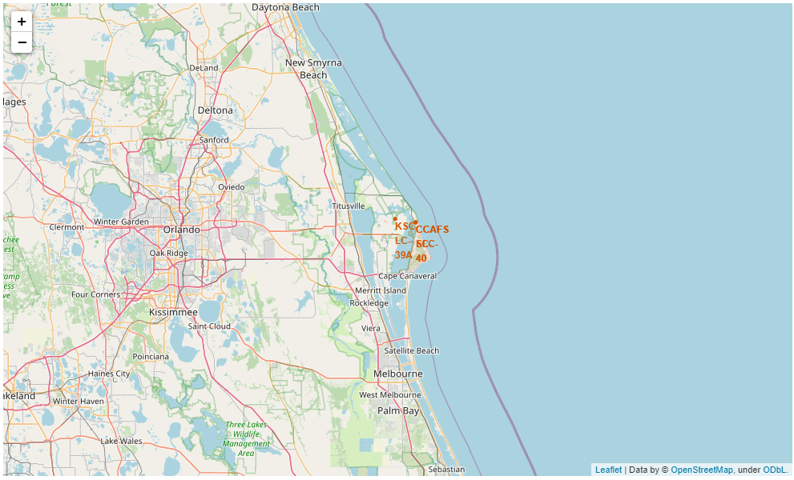
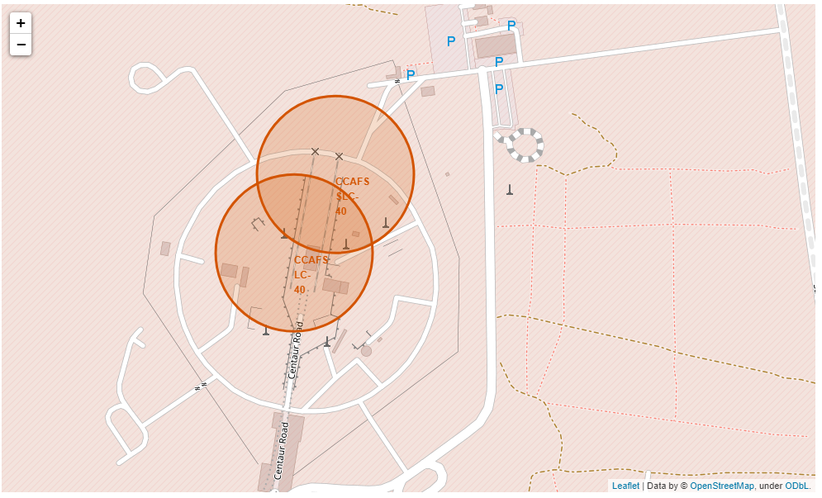
Launch sites

Slide 40

Section 4

Slide 41

Successful Launches by Site
Launch sites are critically important to the success of Space X missions.

Slide 42

Launch Success Ratio for KSC LC
39A
The KSC LC-39A site has the highest success rate with 10 successful landings and 3 failed landings.

Slide 43

Payload Mass vs. Success vs. Booster Version Category
A combination of Payloads under 6,000kg and FT boosters result in a successful combination for missions.

Slide 44

Section 5

Slide 45

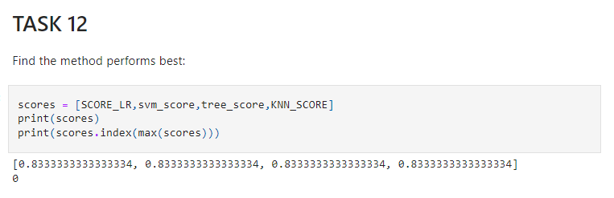
Classification Accuracy
All models obtained a precision greater than 80%
However, for these models the sample size was small, so the models may have significant variations.
We may need more data to determine the best model.

Slide 46
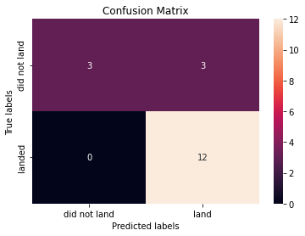
Confusion Matrix
Since all the models performed the same for the test set, the confusion matrix is the same in all the models.

Slide 47
Conclusions
Different public data sources from Space X were analyzed.
Data processing and analysis was performed.
The best launch site was determined to be the KSC LC 39A site.•Launches above 7,000 kg were found to be less risky under current conditions.
Improved mission success rate over time.
Models were generated with an acceptable accuracy greater than 80%, but more data is required for the future, so the models are not applicable to the real world.

Slide 48
Appendix
GitHub repository url:
https://github.com/MasterDuriel/DataScience
Special Thanks to All Instructors

Slide 49


